Slide 1
MPCA LAB MINI PROJECT
PROJECT TITLE: Automated car using Arduino
SECTION: B
STUDENTS NAME: ATHARVA GUPTA
ATUL ANURAG
BHARGAV NARAYNAN P
DANISH HASHMI
SRN’s : PES2UG19CS074
PES2UG19CS075
PES2UG19CS088
PES2UG19CS101

Slide 2
PROBLEM STATEMENT
The most common cause of traffic accidents is the Driver error. With cell phones and other electronic media, in-car entertainment systems, the growing traffic, and complicated road systems, this problem has become bigger than ever. So, to reduce impact in the car, we have made 2 general safety related equipment which are the Sensors for airbags deploying as well as a reverse camera for better visibility.

Slide 3
INTRODUCTION
This is the age of automation where human efforts are reducing to a great extent. Making lives simpler and smarter is the aim of Automation. With smartness of Automation comes information and awareness of the technology around us. With the continuous progress and evolution in information technology and the rising demands of safe travel, it has become necessary to find better and innovative systems to aid human life and make it easier. In current day and age, where the COVID-19 Pandemic has affected us all so deeply, we tried making a system where the main propagation technique of covid is avoided, as well as made a couple general safety related equipment.

Slide 4
PROJECT DESCRIPTION
The functionalities of the project include: -
Utilizing an IR sensor controlled by an IR remote to lock and unlock the door and to power an ultrasonic distance sensor while engaging reverse gear.
Utilizing a backup sensor for better safety in case of low visibility
An automatic Light sensor for both the front as well as the rear of the car
An automatic air-conditioning unit with increases or decreases the temperature based on current conditions in the car.
An airbag sensor for the safety of the passengers of the car in case of an accident.

Slide 5
REQUIRED COMPONENTS
Arduino
Bread Board
IR Remote
IR Sensor
Ultrasonic Sensor
Force Sensor
LDR Sensor
Temperature Sensor
Motor
Buzzer
LCD Screen
LED
Bulb
Connecting Wires

Slide 6
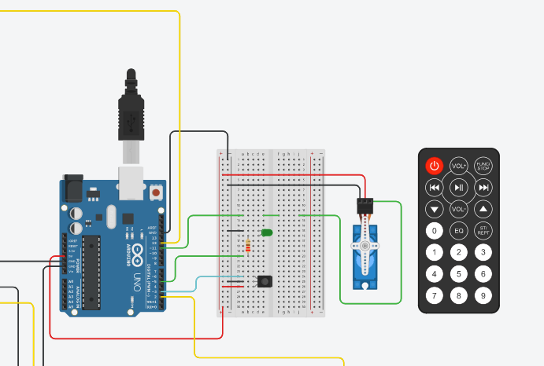
Arduino 1: IR sensor with remote and Micro Servo to access the car

Slide 7
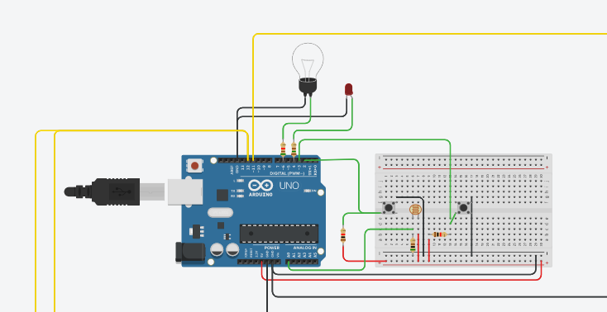
Arduino 2: Adaptive Lighting system using LDR

Slide 8
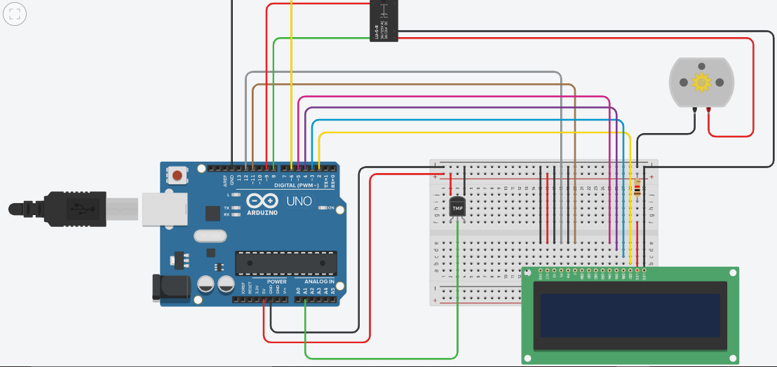
Arduino 3: Temperature sensor with LCD Display for automatic Air Conditioning System

Slide 9
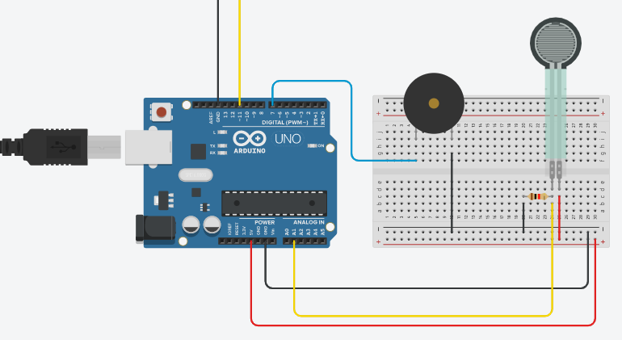
Arduino 4: Force sensor with buzzer for impact detection

Slide 10
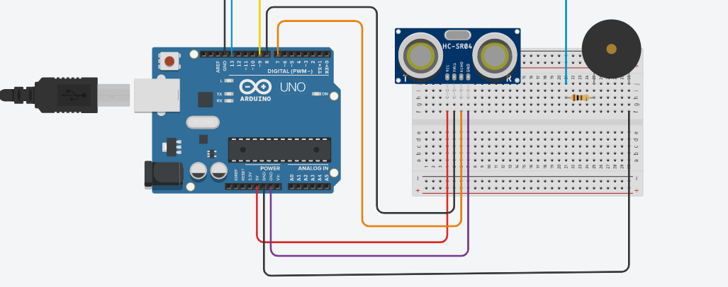
Arduino 5: Ultrasonic Distance Sensor with buzzer

Slide 11
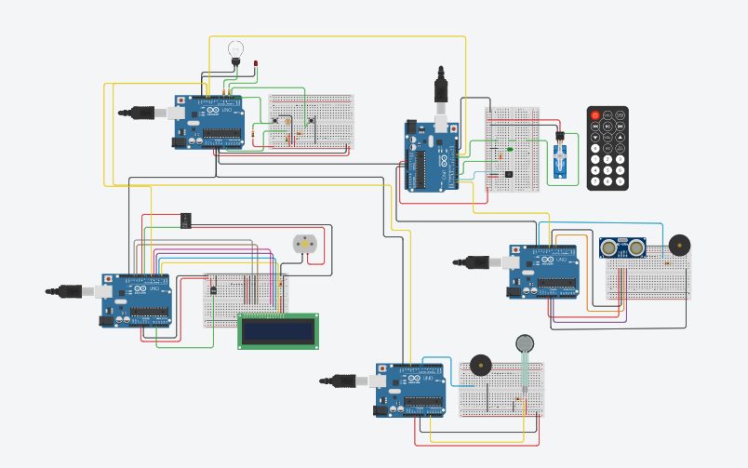
BLOCK DIAGRAM
https://www.tinkercad.com/things/54Mq281FduP-test/editel?sharecode=AICsk-vGvhkQUMvo5T00sb2320wOO6Nd2U0R5LVCM2Q

Slide 12
APPLICATIONS
Prevention of Accident
Protection in case of accident
Prevention of theft
Protection against Covid-19
Automatic Lights for user’s convenience

Slide 13
REFERENCES(Website links, Books etc.)
www.tinkercad.com
www.arduino.cc
www.tutorialspoint.com
www.javatpoint.com

Slide 14
THANK YOU

